Slide 1
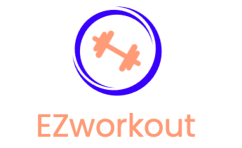

Michael Basazinew
mbasazin@gmu.edu

Slide 2
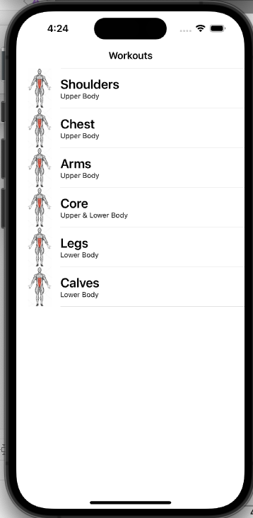
Get Fit!
Workout app for any athletes to optimize their progress
An app that lets you understand each muscle group in depth
YouTube video
Articles from professional athletes/researchers

Slide 3
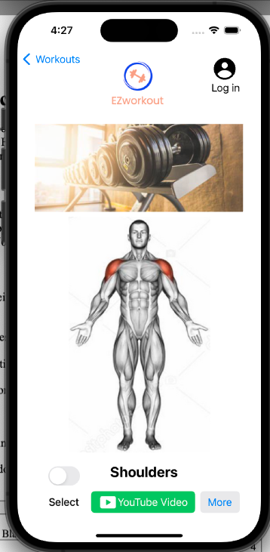
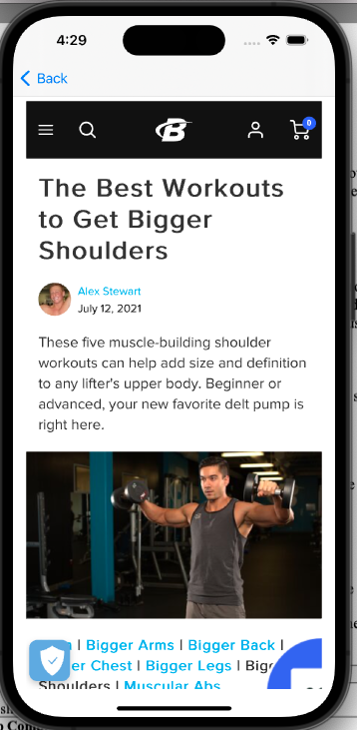
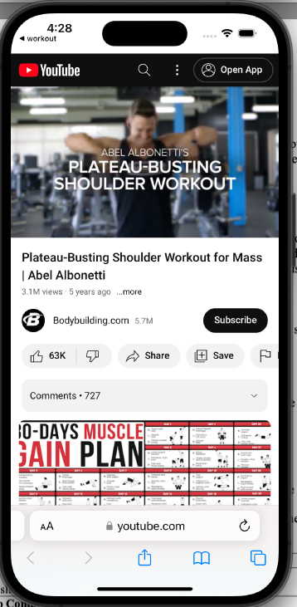

Slide 4
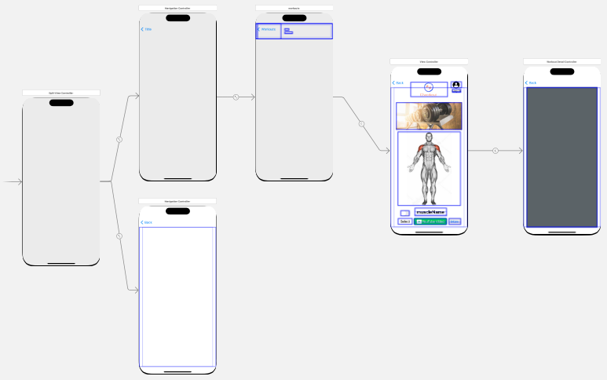
Key concepts
Better understanding of how iOS apps are created
New knowledge of Swift language
Ability to connect APIs for apps
Attention to detail

Slide 5
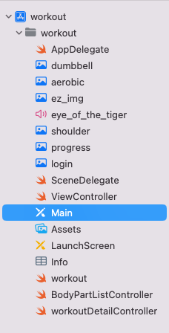
Challenges
Tracking/keeping up with variable names
Understanding how to fix syntax errors
!, ?, .
Deleting buttons or undoing a step

Slide 6
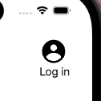
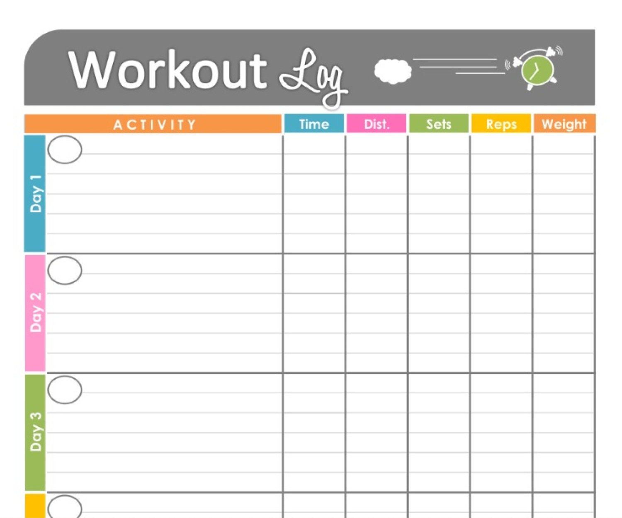
The Future of EZworkout
Add a landing page that allows users to
Login
Select between workouts
Enter their progress and track them
Pick exercise challenges
Ability to share progress with other members

